Slide 1
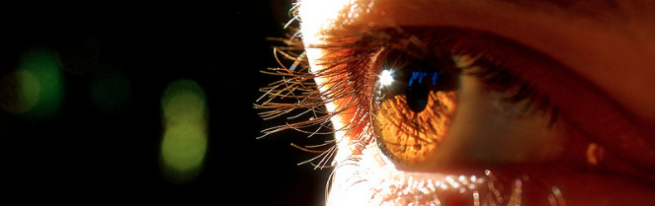
Procesamiento de Imágenes
Domingo Mery
Departmento de Ciencia de la Computación
Escuela de Ingeniería
Universidad Católica de Chile
Filtros
[ Capítulo 3 ]

Slide 2
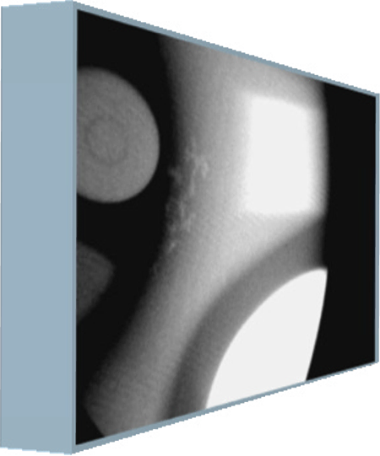
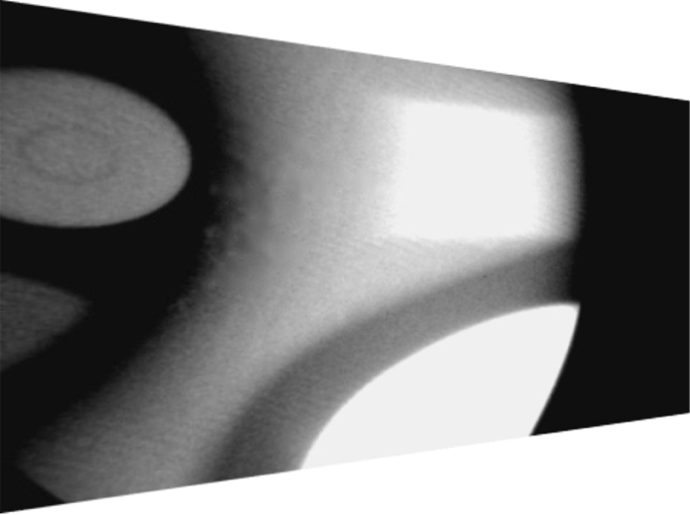

Input Image
Output Image
j
j
Operator
i
i
mask
j
j
Output pixel
f
y(i,j)
i
x(i,j)
i

Slide 3
Pseudocode
Input: image X (N rows and M columns)
mask size (2k+1)x(2k+1)
function (operator)
Output: image Y
for i = k+1 to N-k
for j = k+1 to M-k
M = X(i-k:i+k,j+k-j+k);
Y(i,j) = function(M);
end
end

Slide 4
Example: Linear operator
Pseudocode
Input: image X (N rows and M columns)
mask size (2k+1)x(2k+1)
Linear operator F
Output: image Y
for i = k+1 to N-k
for j = k+1 to M-k
s = 0;
for p=-k:k
for q=-k:k
s = s + F(p+k+1,q+k+1)*X(i+p,j+q);
end
end
Y(i,j) = s;
end
end

Slide 5
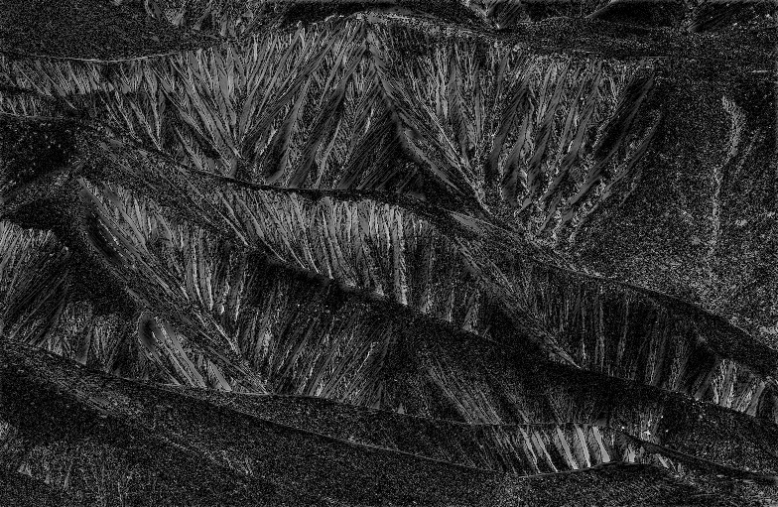
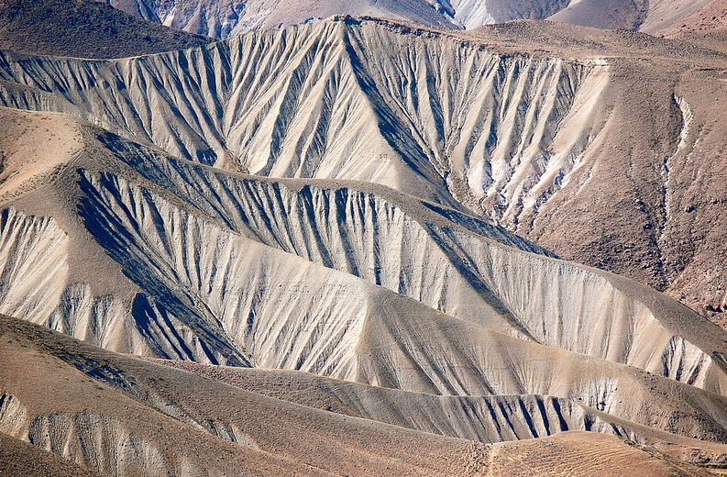
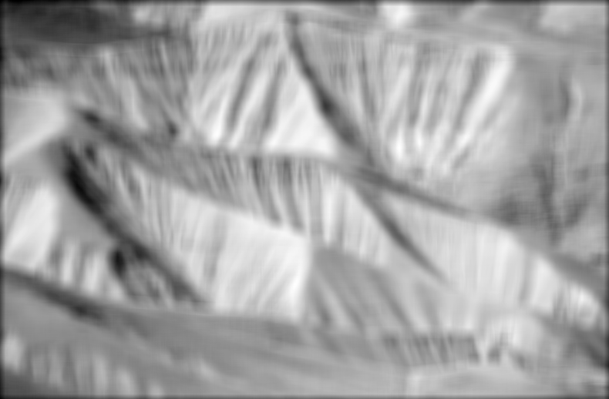



Slide 6
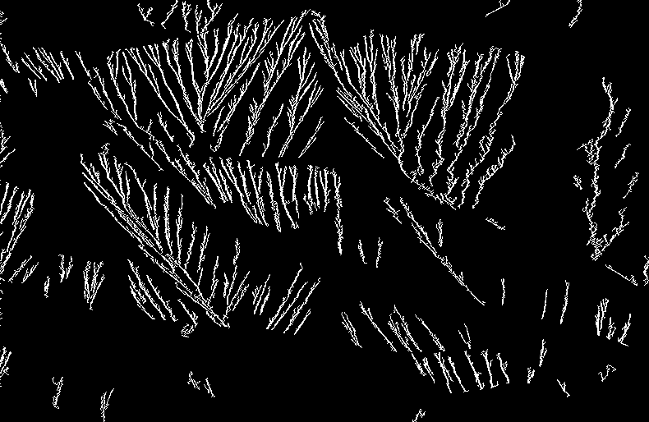
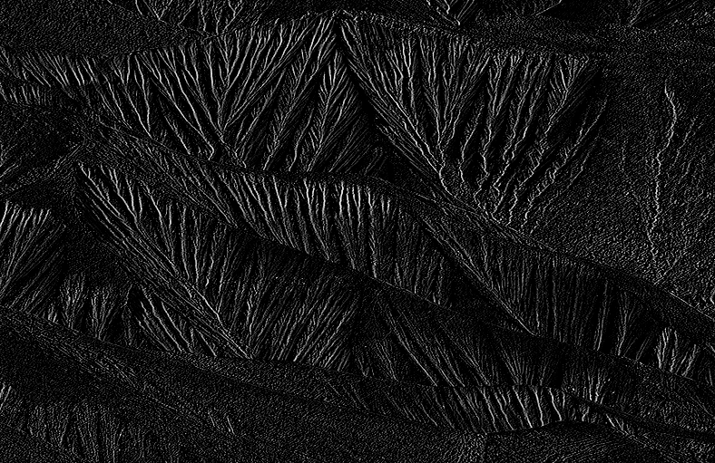


Slide 7

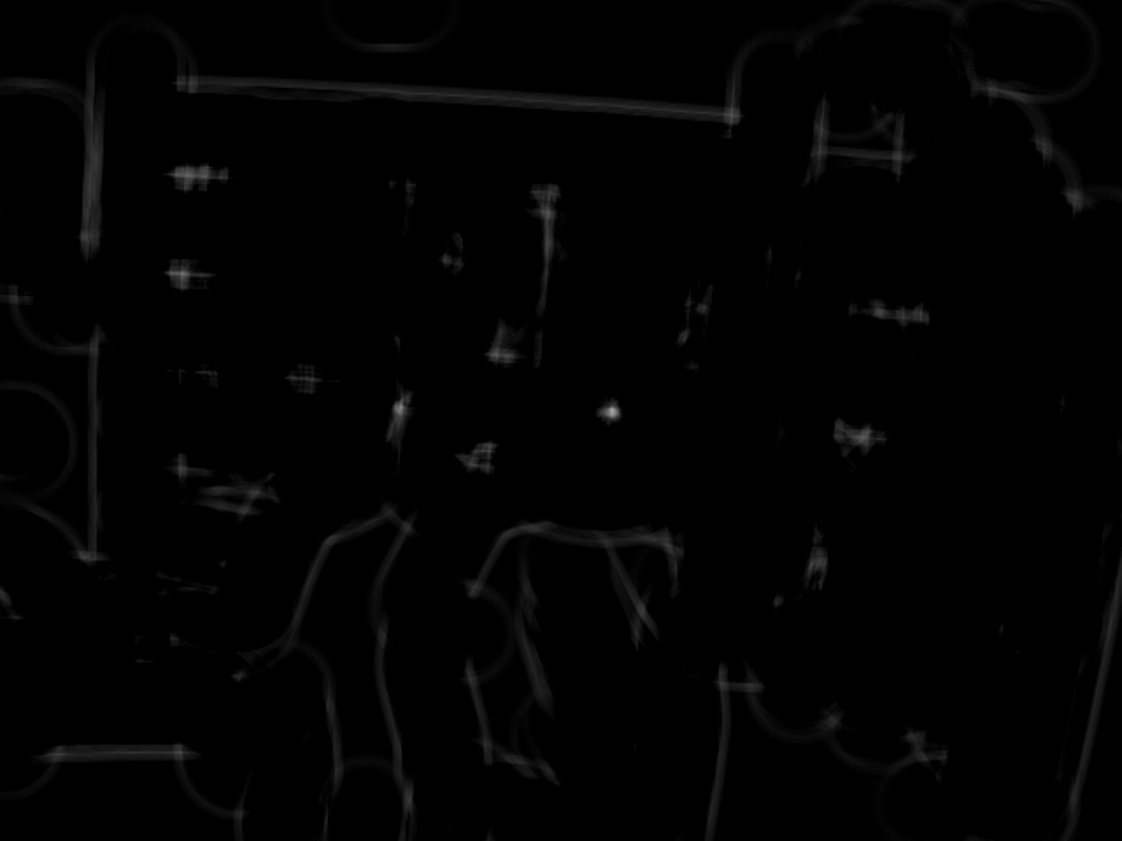
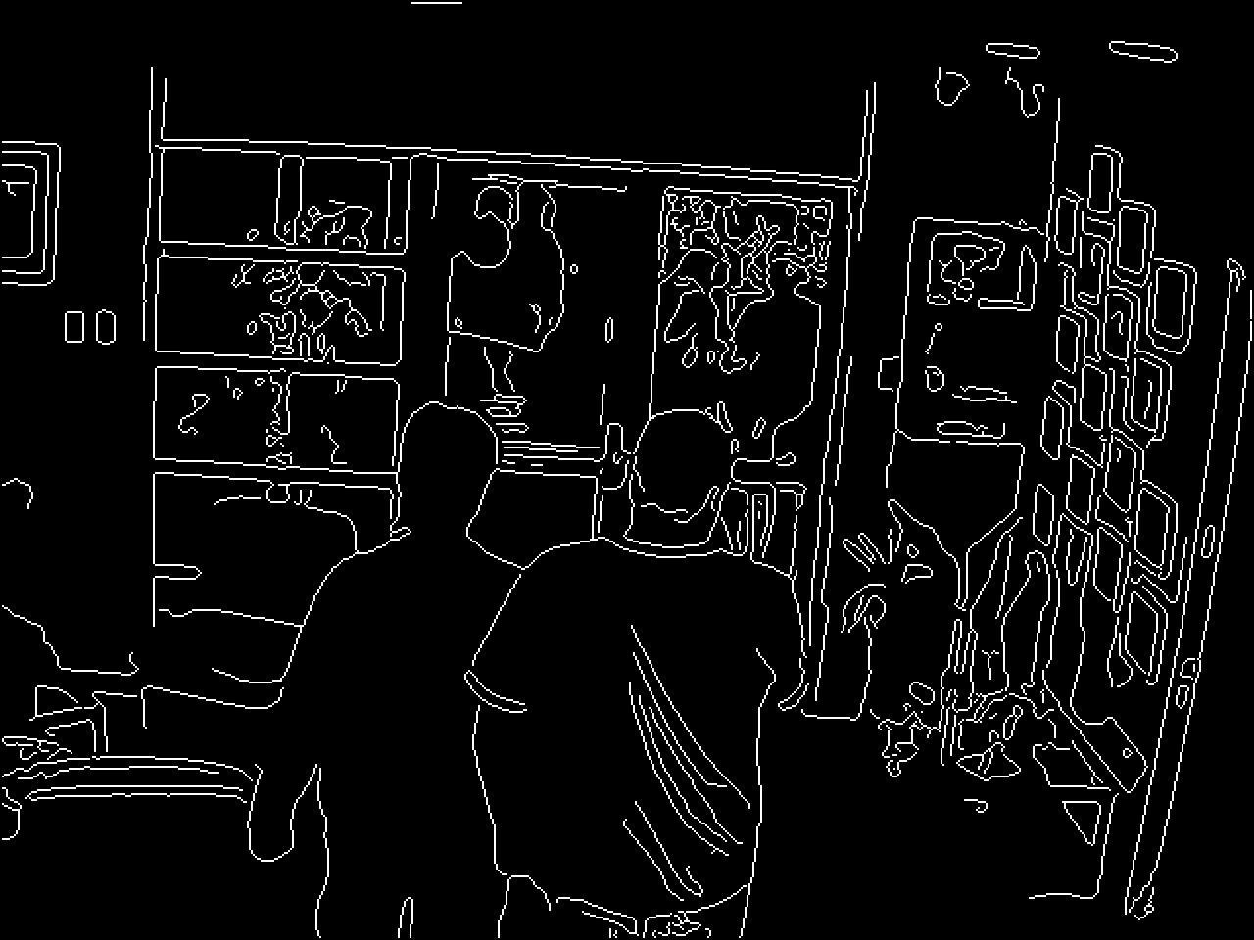
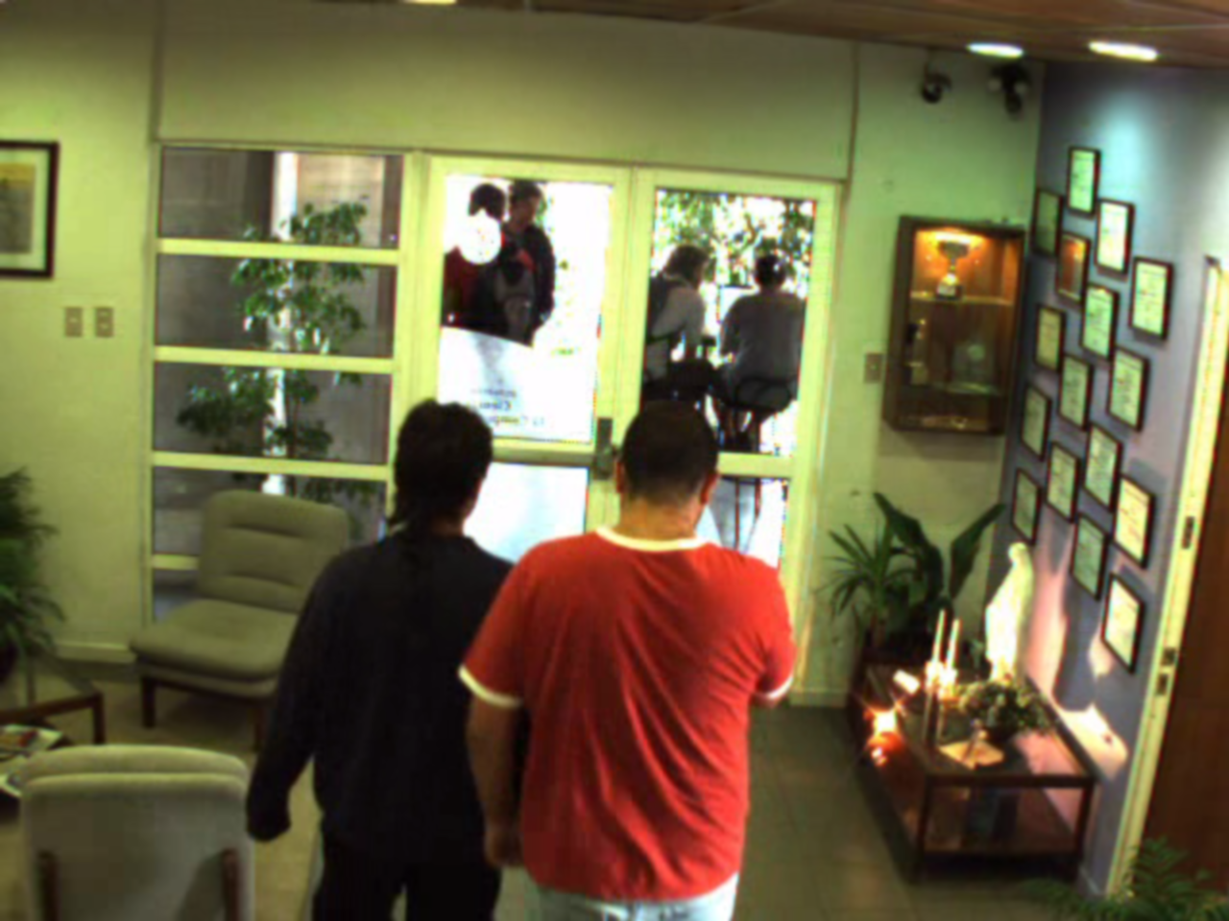

Example: Head detection
© Hans Löbel

